Slide 1
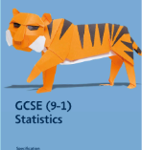

GCSE STATISTICS
At CVC

Slide 2


Slide 3

Is statistics right for me?
We are living in the age of data
Statistics are being used at an increasing rate in business, politics and science ( and even social media)

Slide 4

GCSE Statistics
Enriches and extends the statistics topics taught as part of GCSE Mathematics.
Introduces more advanced statistical methods and ideas. These have applications in many school subjects and a wide range of careers.
Develops students as critical thinkers and encourages them to ask questions about data and analyse what the data tells them
Builds skills in working with probability.
Almost all career paths and occupations involve statistics
Being able to understand the statistics presented to us in everyday life is essential in today’s world.

Slide 5

Lessons:
2 hours after school one day each week

Slide 6
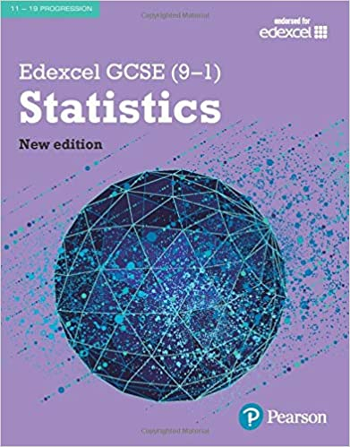
Resources
All lesson saved on OneNote
Regular use of a course textbook
Access to revision resources and printed past papers

Slide 7
What support will I have?
Access to all of your past lessons online
Experienced teacher available to help you
Revision time in summer term

Slide 8
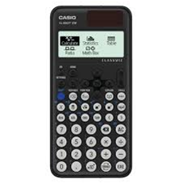
How is it examined?
Exam Board – Pearson Edexcel Statistics (1ST0)Higher Tier.
Two exam papers 90 minutes each- 50% split, mocks around February half term
Both exams are calculator papers (we recommend the Casio FX-85GT CW)

Slide 9
